Slide 1
The NCM system
Giulia Sofia, PhD

Slide 2
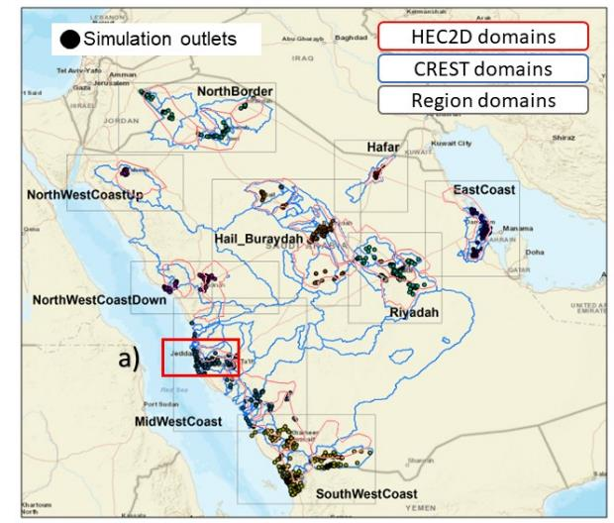
Key features
The NCM flash-flood forecasting system
KEY FEATURES
Hydrologic simulations for >100 watersheds
  Hourly discharge
2d hydraulic simulations for over 700.000 km²
  Flood depth at 30m resolution
  2.5m resolution over critical areas
4 times a day
120 hours forecast
33

Slide 3
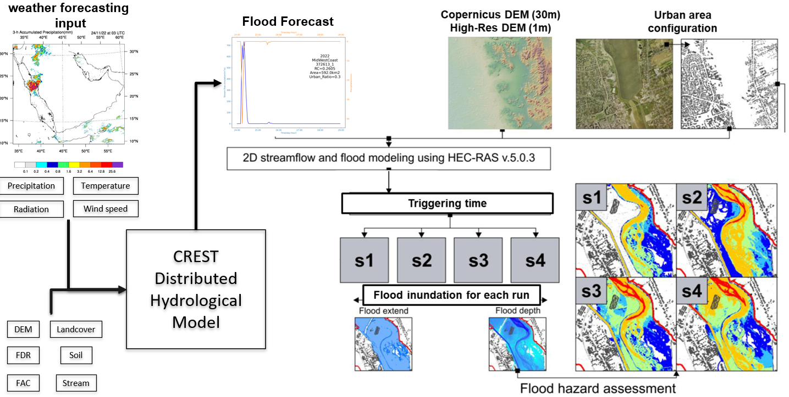
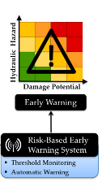
Key features
Copernicus DEM (30m)
AW3D DEM (2.5m)

Slide 4
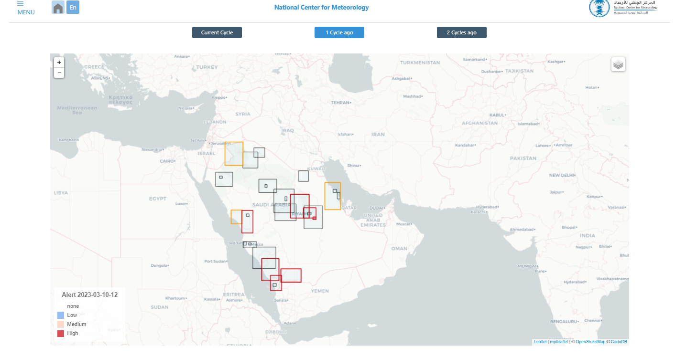
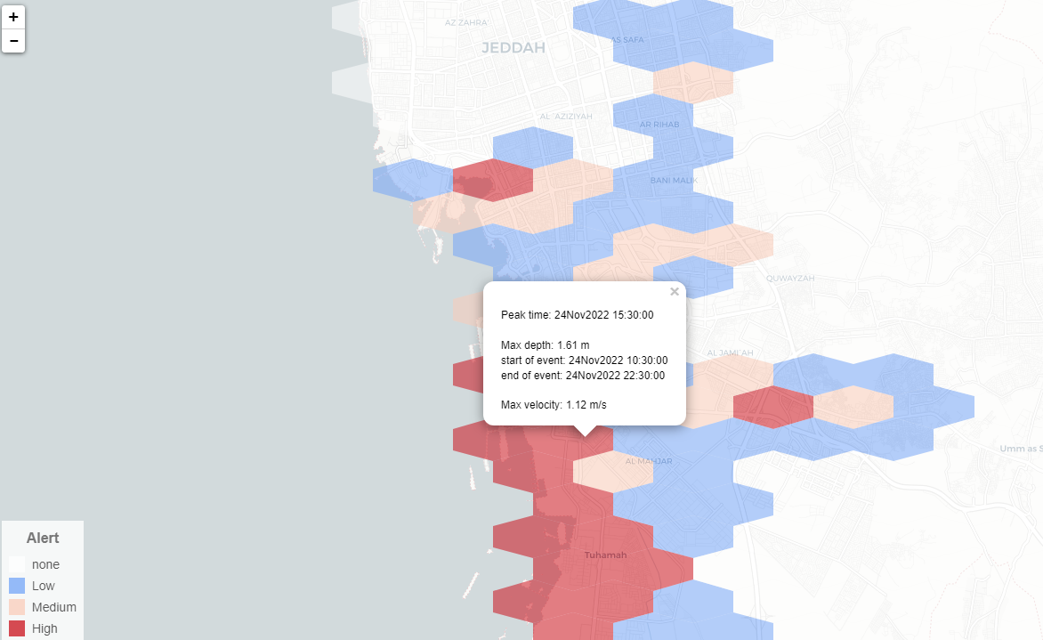
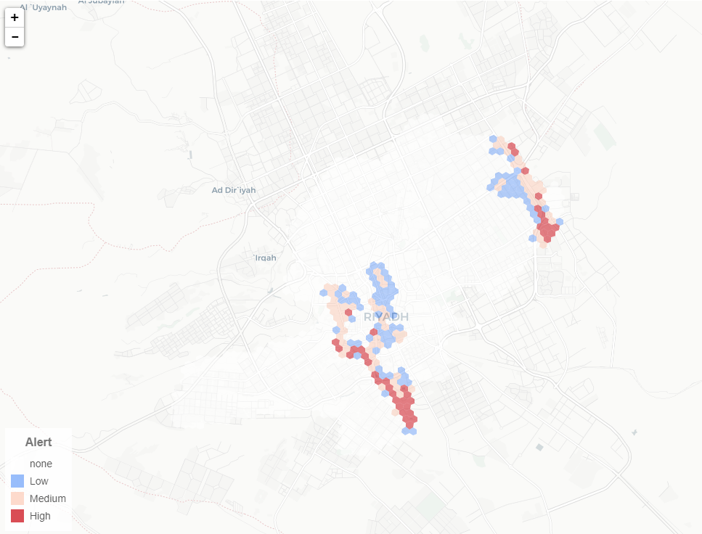
Key features
Copernicus DEM (30m)
AW3D DEM (2.5m)

Slide 5
Operationally
The NCM system is built based on python routines, relying on common available packages.
The routines still need each HEC-Ras Project to be created and run at least once in windows.
The routines perform the following tasks
Gathering of the Hydrologic model results
Clean-up of the existing inputs for HECRas
Read the timeserie of flows, and embed them into the HECRas files
Polish the files and convert them into RAS *.b01 files
Launch HECRas [linux]
Gather the results
Interpolate depth and velocity
Compute warning levels at the hexagons
Produce HTML outputs
These steps are performed separately and in parallel for each domain. Finally, a python routine gathers the results from each domain, and merges them into a single html output.

Slide 6
Questions?
33

